Slide 1

Chapters 3-4 Presentation: Alpha University
Group 7:
Ashley mikel, cameren sudduth, diana cesar

Slide 2
Entity | Attributes
Donor | DonorID, name, address, phone, email, category, job, lastYearDonation, currentYearDonation
Pledge | PledgeID, amountPledged, dateOfPledge, numOfPayments, paymentMethod, creditCardNumber
Payment | PaymentID, amount, dateReceived, dueDate
Employer | EmployerID, name, address, contactPerson
Event | eventName, eventDate
DonorCircle | circleName, amountThreshold
ClassYear | year

Slide 3
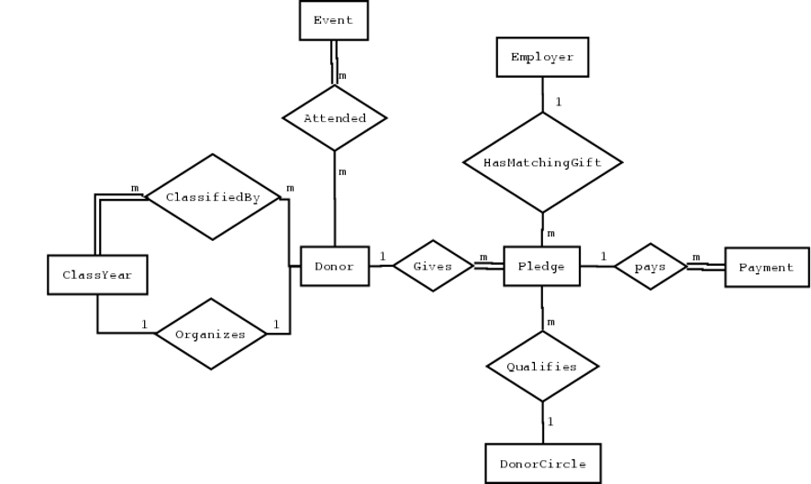
ER Diagram

Slide 4
Relational Schema
1. Donor (DonorID, name, address, phone, email, category, job, lastYearDonation, currentYearDonation, coordinatorYear)
coordinatorYear is a FK to ClassYear
2. Pledge (PledgedID, amountPledged, dataOfPledge, numOfPayments, paymentMethod, creditCardNumber, DonorID, EmployerID, circleName)
DonorID is a FK to Donor
EmployerID is a FK to Employer
circleName is a FK to DonorCircle
3. Payment (PaymentID, amount, dateReceived, dueData, PledgeID)
PledgeID is a FK to Pledge
4. Employer (EmployerID, name, address, contactPerson)
5. Event (eventName, eventDate)
6. DonorCircle (circleName, amountThreshold)
7. ClassYear(year)
8. Attended (DonorID, eventName)
eventName is a FK to Event
DonorID is a FK to Donor
9. ClassifiedBy(DonorID, year, role)
DonorID is a FK to Donor
year is a FK to ClassYear

Slide 5
Thank you!

